Slide 1
Wireless OBD-2 Diagnostic Tool with touchscreen
Zak Rowland
Senior Project Proposal

Slide 2
My Solution
Small Bluetooth transceiver powered by the OBD-2 port to send data
Handheld unit will include:
Single board computer (such as Raspberry Pi Zero W)
A Bluetooth transceiver
Resistive touchscreen
Rechargeable battery via Micro USB
Simple user interface
Basic functionality to keep costs low

Slide 3
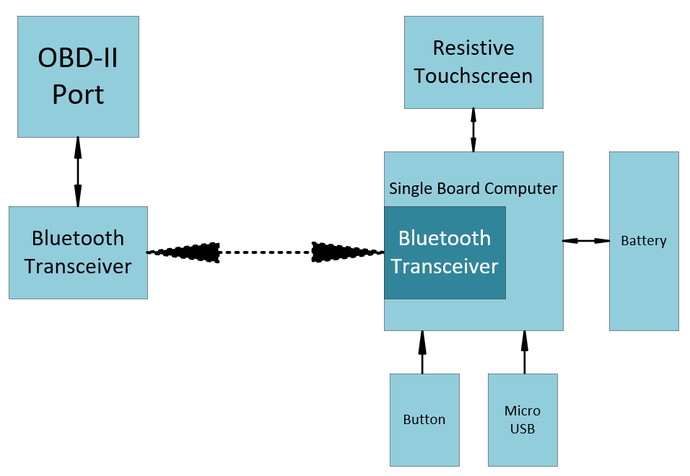
System Block Diagram

Slide 4
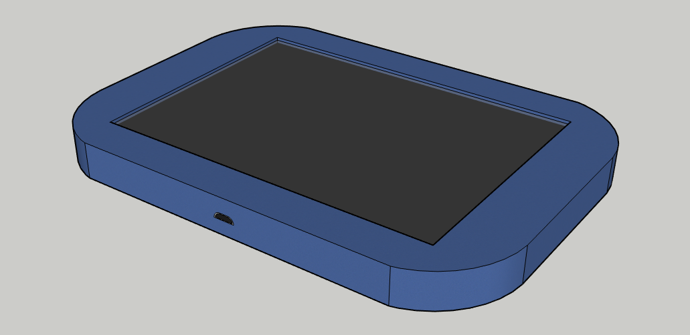
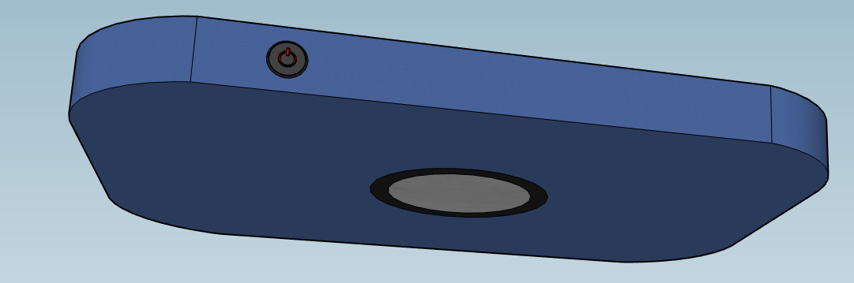
What will that look like?
Power Button
Magnet
Micro USB
Touchscreen

Slide 5
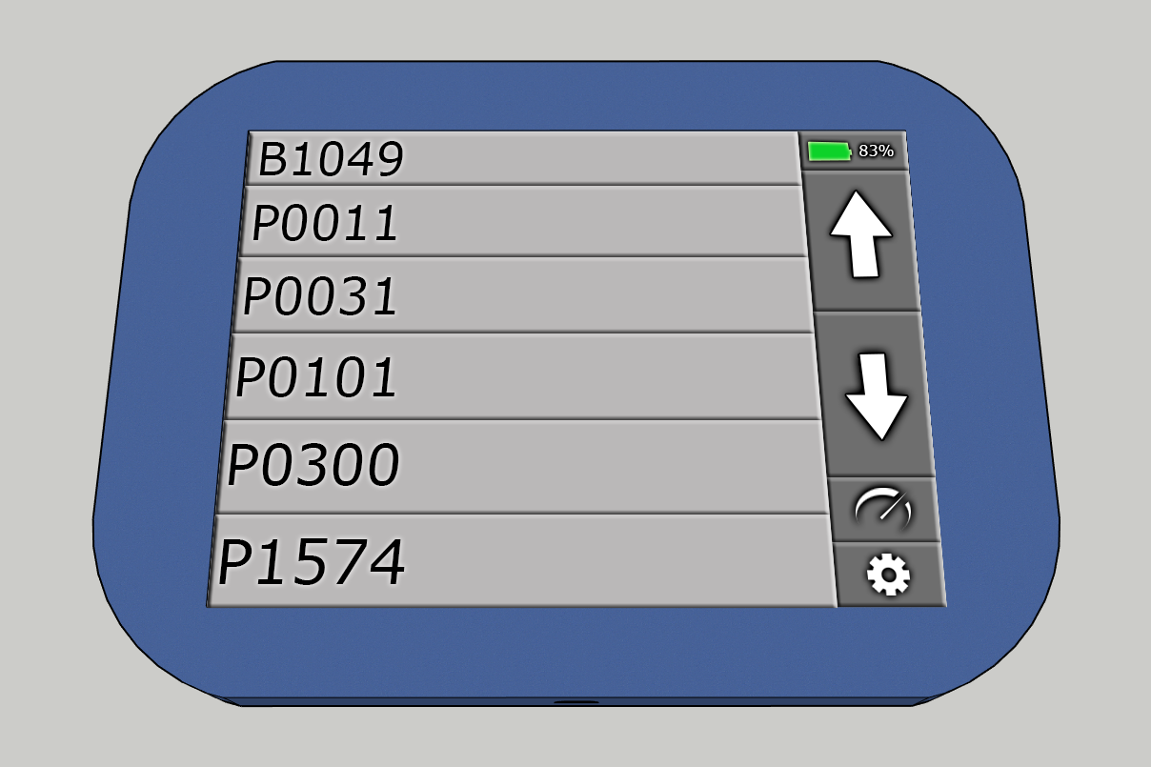
What about the ui?
Battery Status
Trouble Codes
Scroll Up and Down
Sensor Data
Settings

Slide 6
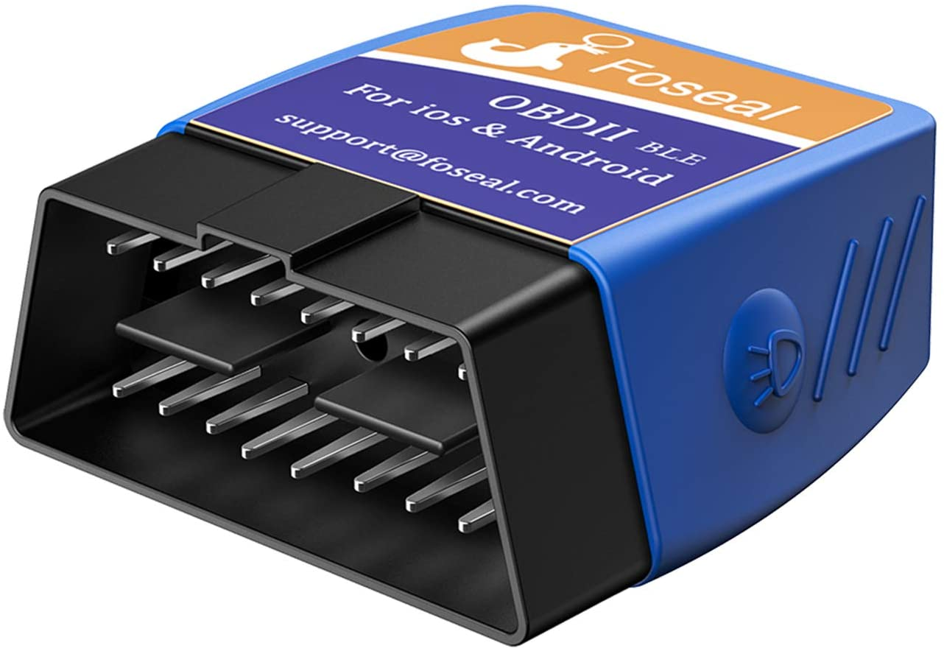
What about the current tools that exist?
One product is the low-cost Bluetooth readers that connect to a phone app
How is my solution better?
No sketchy software to install on your phone
Dedicated handheld unit
Can be mounted with magnet
Phone can be used for other things
Single board computer is reprogrammable
Features can be added if the user desires
Open source
source

Slide 7
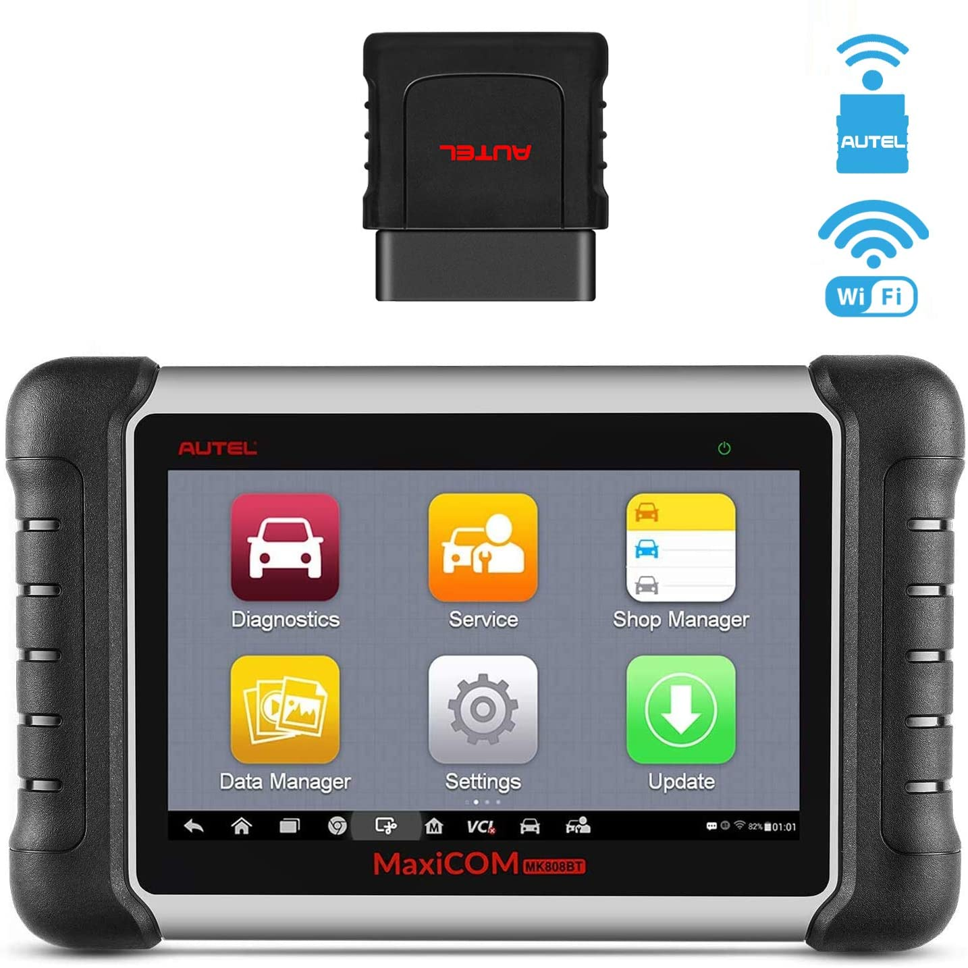
What about the current tools that exist?
Another product is this Wi-Fi connected unit that is similar to my proposed solution
How is my solution better?
The unit pictured is over $500
My target is under $150
Simple, more user-friendly interface
Only includes most necessary features
Single board computer is reprogrammable
Features can be added if the user desires
Open source
source

Slide 8
Requirement Examples
The system shall work with the 2008 Nissan Altima OBD-II protocol
ISO15765-4 (CAN-BUS)
Other vehicles may work however it is not a requirement
The Bluetooth transceiver circuit that interfaces with the OBD-II port shall be powered by the OBD-II port
A power circuit will be designed to ensure power from the port is reliable

Slide 9
Another Requirement Example
The handheld unit shall use a resistive touchscreen to display information and receive user input
The touchscreen of the handheld unit shall be 3.5” or greater diagonally
The touchscreen of the handheld unit shall operate at a resolution of at least 320 x 480 pixels
Resistive instead of capacitive because
Cost is lower
Can be used with gloves (or anything really)
Swiping or gestures won’t be used

Slide 10
Why is this product worth developing?
There is no wireless low-cost unit with the basic features that I described that doesn’t connect to a smart phone
Open source code and documentation allows the product to be improved or features be added as the end user sees fit
I will learn about many new protocols and hardware including OBD-II, CAN, Bluetooth, touchscreen interfacing, and more

